Slide 1

🚗Used Car Price
Prediction
A Machine Learning Project with Flask Web Deployment
👩‍💻 Project by: Ritika Jaiswal
💡 Task Assigned by: Kamal Sir

Slide 2

Problem Statement
The goal is to build a machine learning model that accurately estimates the resale price of used cars (Maruti, Tata, Mahindra) based on:
Brand (categorical)
Age (years)
Kilometers Driven (km)

Slide 3


For Buyers:
Avoid overpaying for used cars.
Compare prices across brands/age/km combinations.
For Sellers:
Set competitive resale prices.
Negotiate better deals using data-backed insights.
Use Case:
Used car dealerships can automate pricing.
Online platforms (e.g., OLX, Spinny) can integrate this model for price suggestions.
For Businesses:
02

Slide 4
Dataset Summary
🔹 Input Features
Column | Description | Data Type | Range/Values
car_name | Brand of the car | Categorical | Maruti, Tata, Mahindra
age_years | Age of the car (in years) | Numerical | 1–10 years
kms_driven | Total kilometers driven | Numerical | 5,000–100,000 km
🔸 Target (Dependent Variable)
Column | Description | Data Type | Range/Values
price | Resale price of the car | Numerical | ₹70,000–₹5,00,000
02

Slide 5
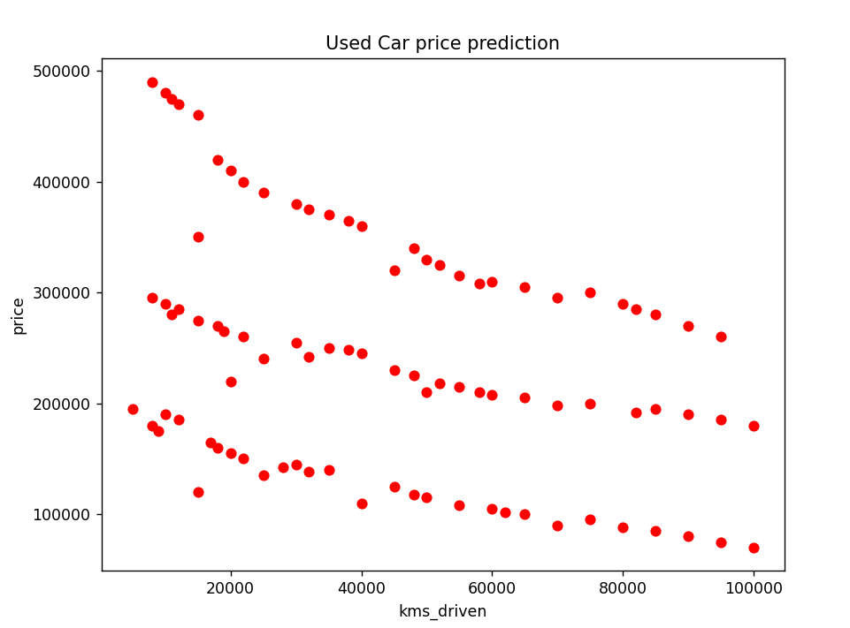
Dataset Visualization

Slide 6
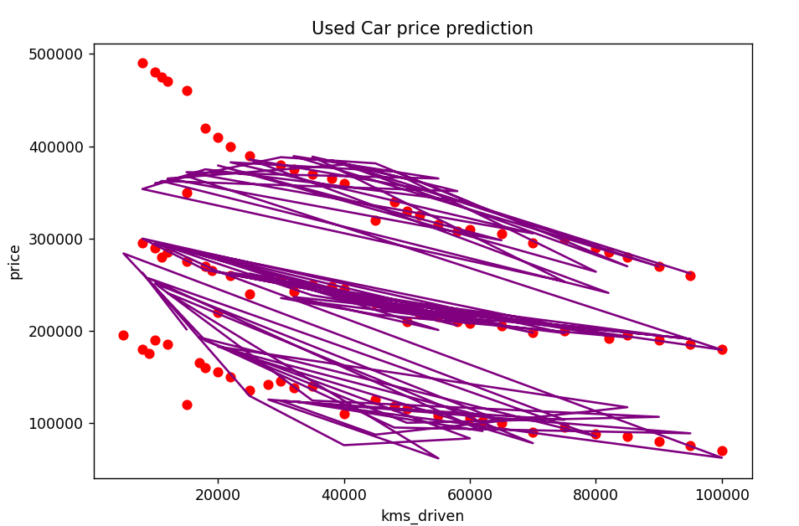
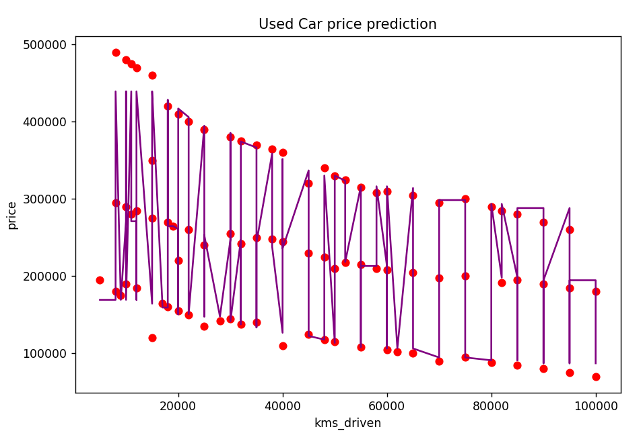
Visualizing Regression Line: Price vs Kilometers Driven
Price vs Kilometers Driven (Polynomial Fit Degree 3)
Price vs Kilometers Driven using KNN Regression (k = √n)

Slide 7
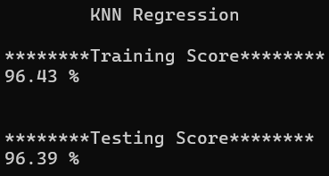
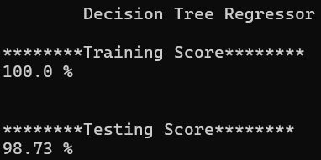
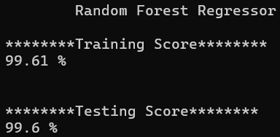
🔍 Comparing KNN, Decision Tree & Random Forest Regressors
KNNR Regressor
Decision Tree Regressor
Random Forest Regressor
Achieved high accuracy with 96.43% training and 96.39% testing scores.
Performs well but may not capture complex data patterns.
Perfect training score (100%) but slightly lower testing at 98.73%.
Might be overfitting the data a little.
Very high accuracy on both training (99.61%) and testing (99.6%) data.
Gives better generalization than a single decision tree.

Slide 8
✅ Model Selection & Preprocessing (Random Forest)
04
02
02
03
Scaling is not required for Random Forest, as it is a tree-based model and not sensitive to feature magnitudes
05
Applied get_dummies() to convert them into numerical format using one-hot encoding
Set random_state to ensure consistent and reproducible results on every model run.
Used n_estimators = 200 to build the model with 200 decision trees, to reduce overfitting
01
Choosed Random Forest Regressor for its robustness, ability to handle categorical and numerical features, and high accuracy in prediction.
06
After training, the model was saved using pickle, so it can be loaded and used later without retraining
Reproducibility
Feature Scaling
Categorical Data Handling
Hyperparameter Tuning
Selected Model
Model Serialization

Slide 9
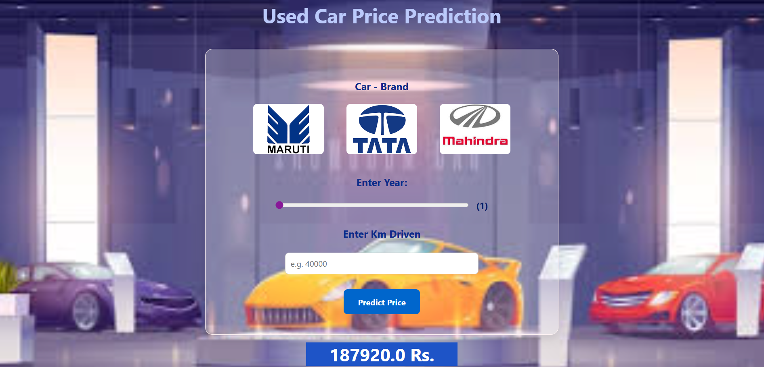
Car Price Prediction — Project Interface Overview
View Project Online: https://carpred.pythonanywhere.com/

Slide 10
🔧 Tools & Technologies Used
✅ 1. Python (v3.10 or v3.11)
Core programming language used for data processing, model building, and backend scripting.
✅ 2. Notepad
Used for writing and testing machine learning code interactively.
✅ 3. Flask (v2.x)
Python web framework used to build the web application.
Helps serve the ML model and take user input through a web interface.
✅ 4. HTML, CSS & JavaScript
For creating the frontend user interface (car image buttons, input sliders, and styled output).
📚 Libraries Used
✅pandas (v1.5+) - For data loading, exploration, and preprocessing.
✅matplotlib (v3.6+) - For data visualization like scatter plots and trend lines.
✅sklearn (v1.2+) - To build machine learning models (KNN, Decision Tree, Random Forest).
✅pickle (builtin) - To save and load the trained ML model.
🌐 Hosting Platform
PythonAnywhere

Slide 11
Learning
Understood data preprocessing using get_dummies() for categorical features.
Learned that scaling is not required for Random Forest models.
Used random_state for reproducible results.
Tuned n_estimators in Random Forest to improve accuracy.
Saved the trained model using pickle for future use.
Visualized different regression models to compare performance.
07

Slide 12
🙏 Acknowledgement
I would like to sincerely thank Mr. Kamal Sir for assigning this project. This task helped me polish and apply all the Machine Learning skills I have learned from him, enhancing both my understanding and practical experience.
THANK YOU

